Slide 1
Hands-on Machine Learning with Spark
Yushu Yao
UC Berkeley

Slide 2
Plans For Today
Simple Classifiers
Random Forest
Different ensemble methods
Spark ML
Hands-on

Slide 3
Logistic Regression for Classification

Slide 4
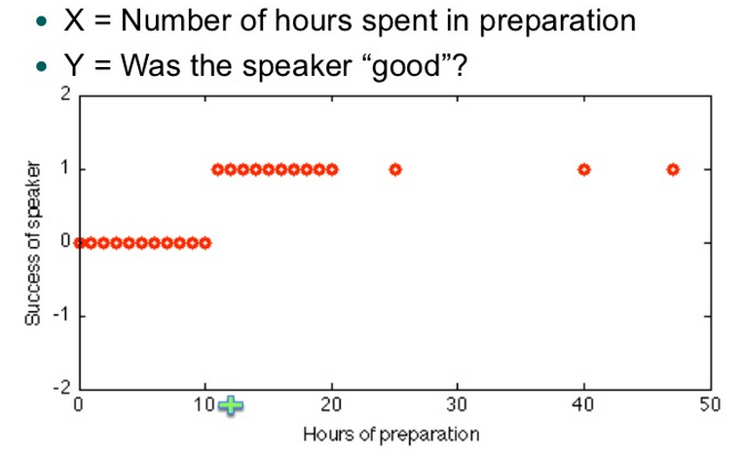

Slide 5
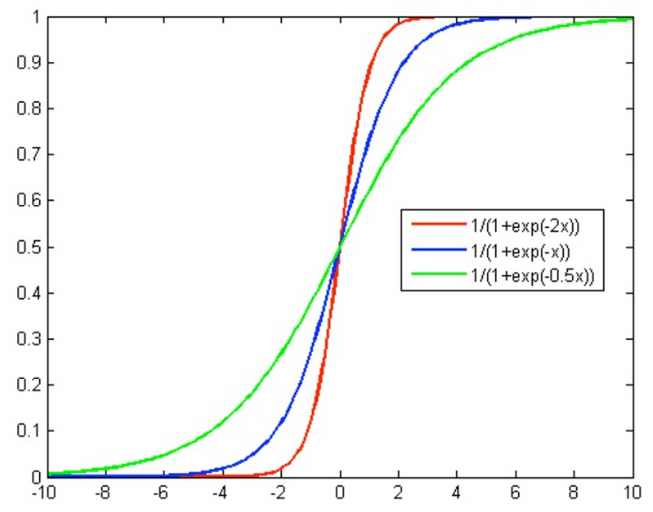
Logistic Func

Slide 6
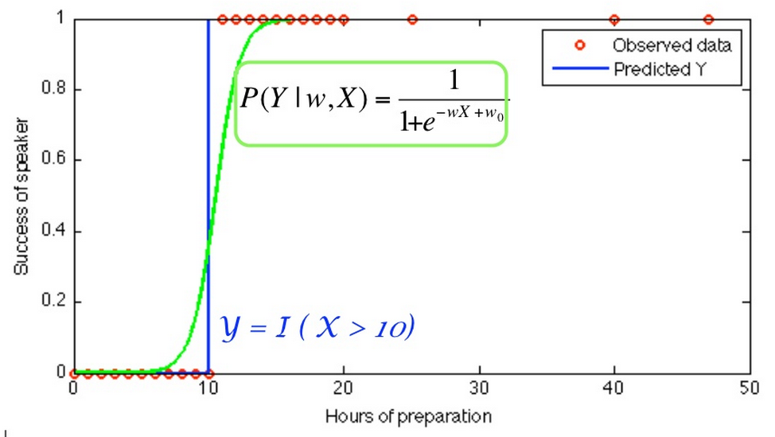

Slide 7
Support Vector Machine for Classification

Slide 8
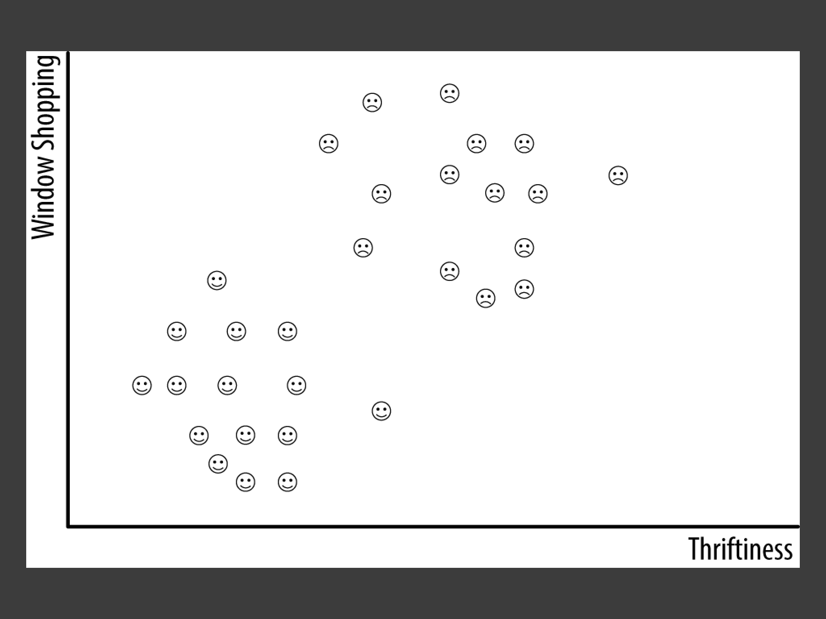

Slide 9
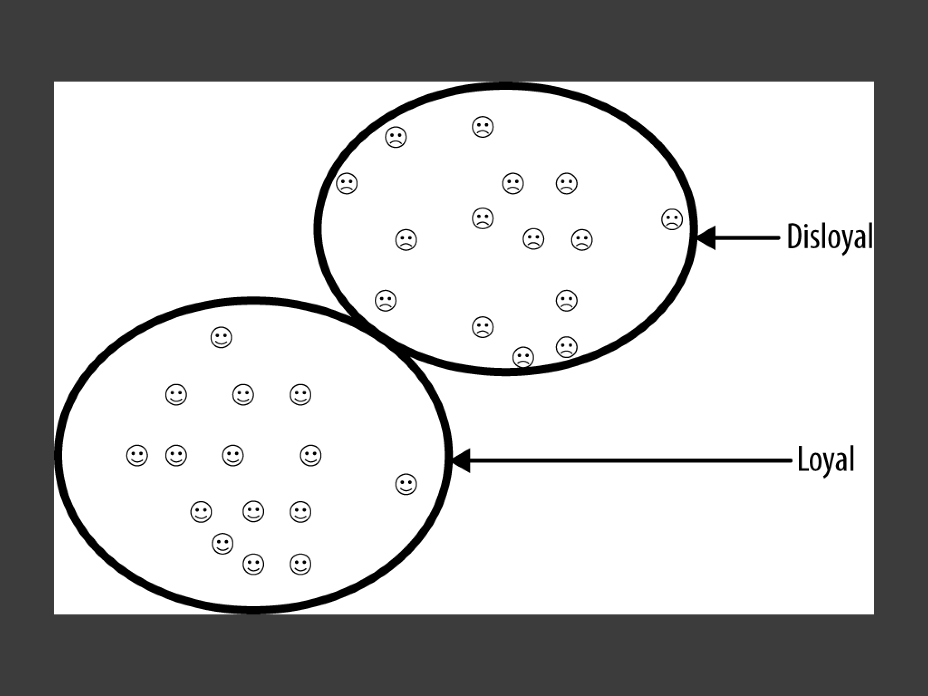

Slide 10
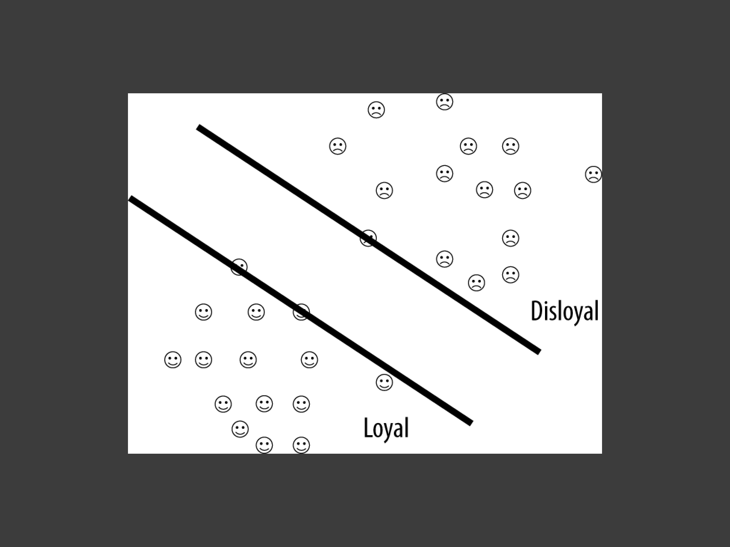

Slide 11
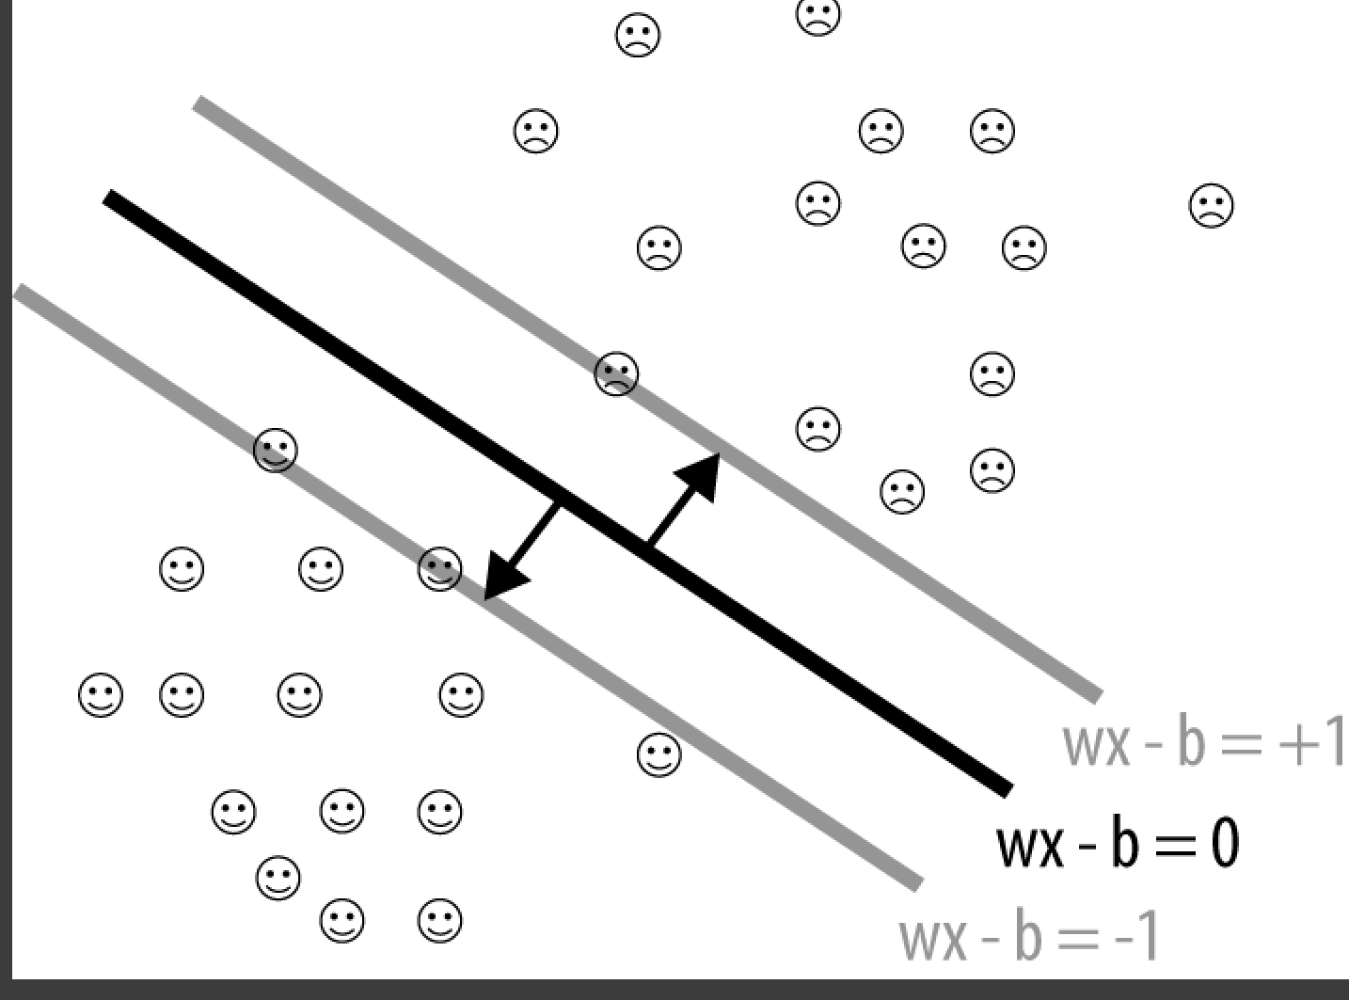

Slide 12
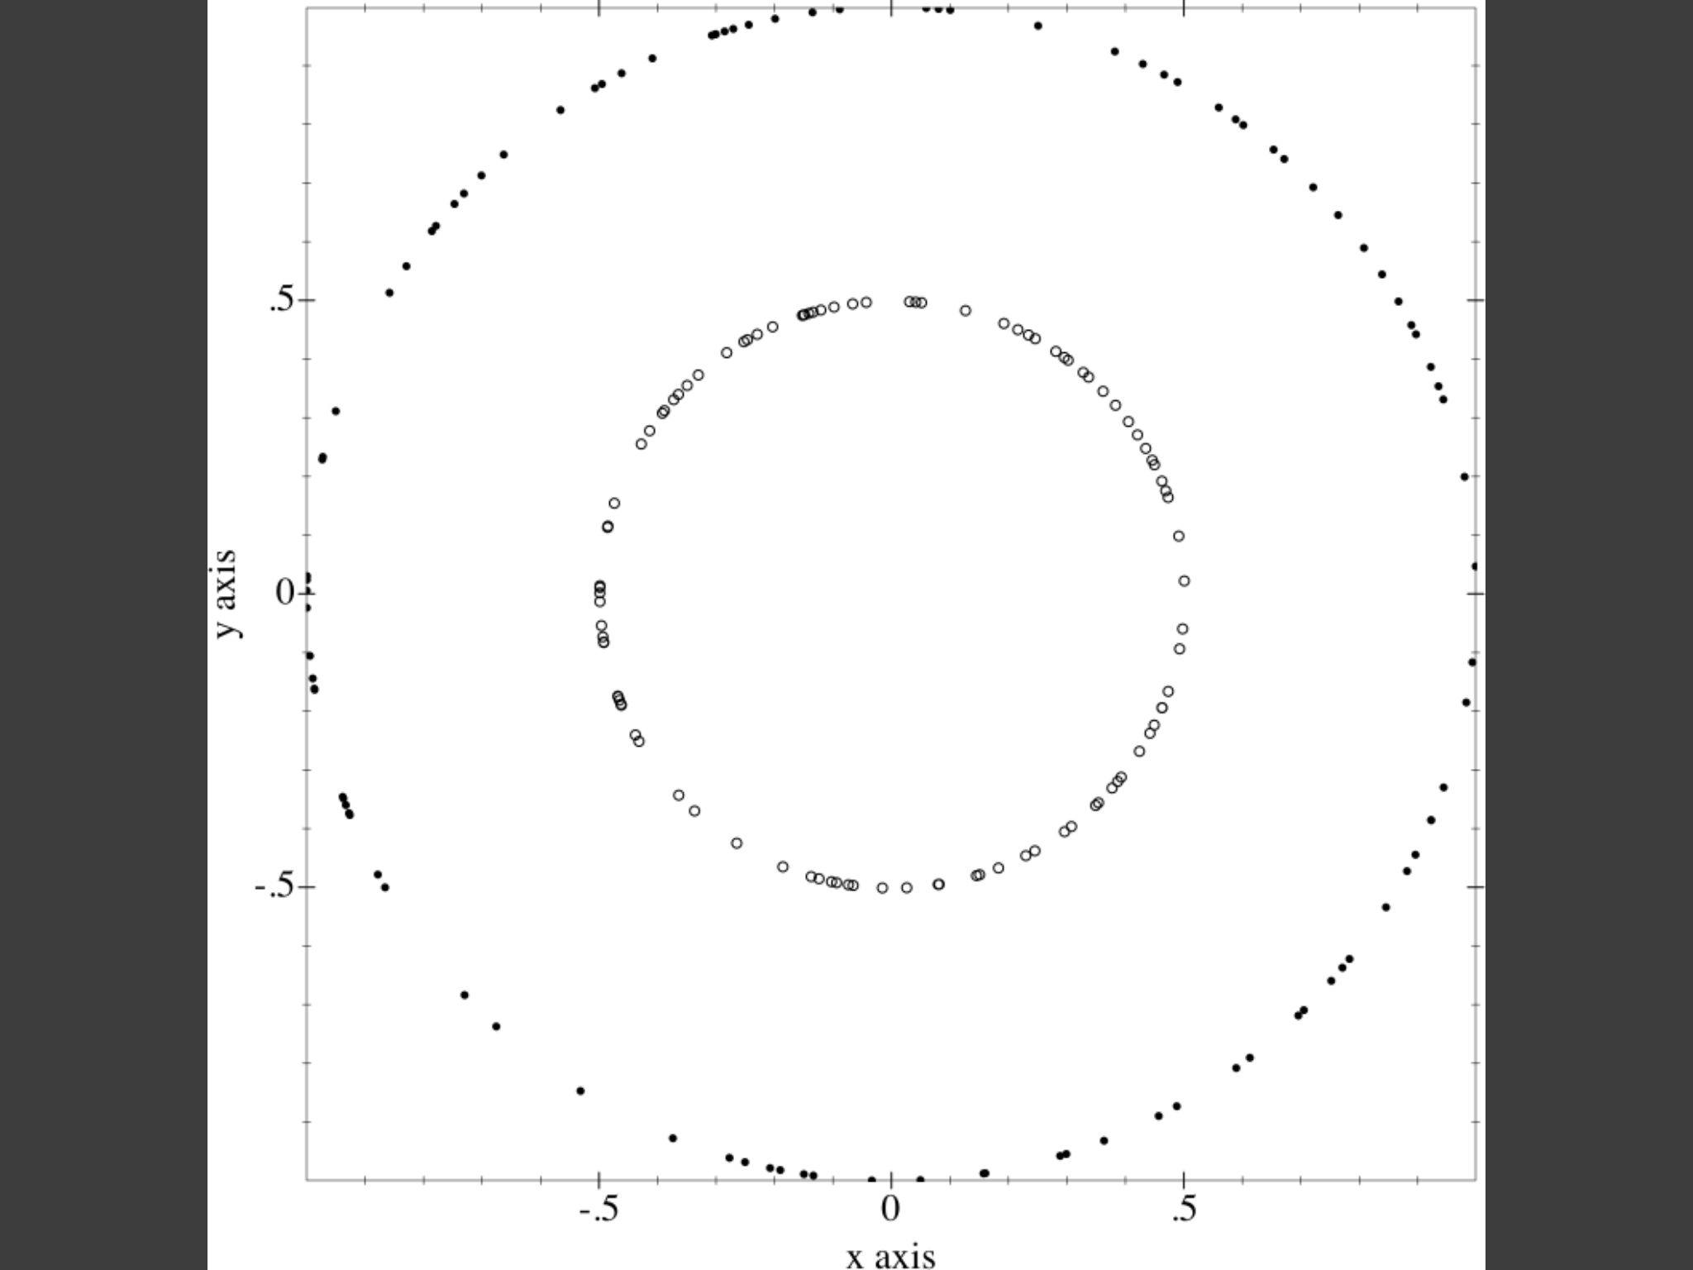

Slide 13
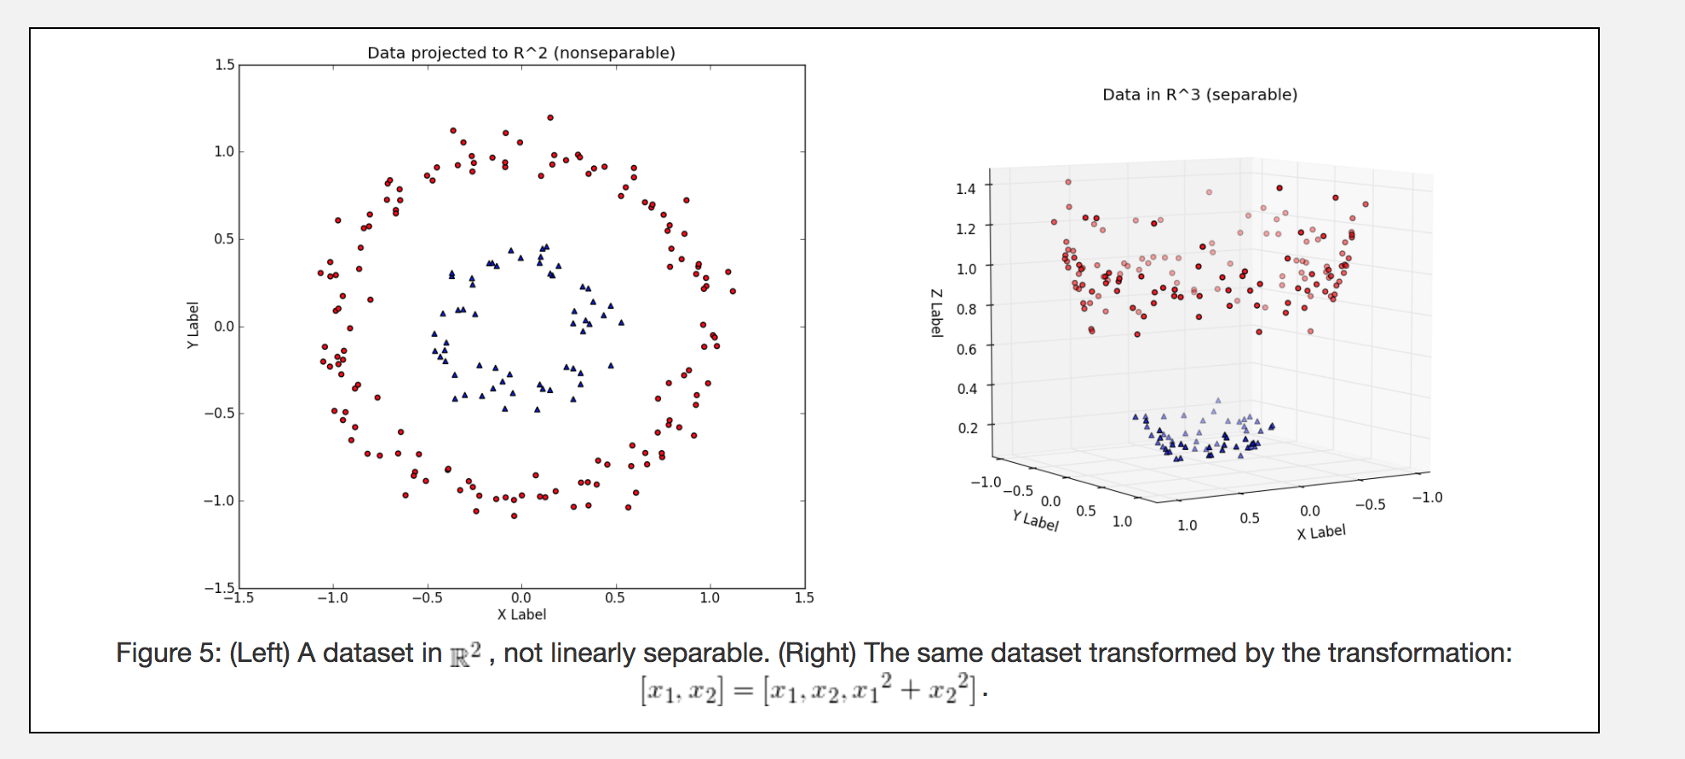

Slide 14
Decision Tree

Slide 15
A Simpler Classification Tree
Function f(X,Y)
Tree form of f(X,Y)
Y
Y<4
0
X<3
0
4
1
2
Y<2
2
2
2
2
1
3
X
Notes:
‹#›

Slide 16
Function f(X,Y)
Tree form of f(X,Y)
Y
Y<4
0
X<3
0
4
3
2
Y<2
2
5
2
5
3
3
X
Fit a tree model to data.
Recursive Partitioning Algorithm.
At each node we perform a split: we chose a variable X and a value t that minimizes a criteria.
The split: L = {X < t} ; R = { X ≥t}
Notes:
‹#›

Slide 17
ID3 Algorithm
To construct decision tree T from learning set S:
If all examples in S belong to some class C Then make leaf labeled C
Otherwise
select the “most informative” attribute A
partition S according to A’s values
recursively construct subtrees T1, T2, ..., for the subsets of S

Slide 18
Most Informative Split
Maximizes Information Gain
How do we measure it?
Entropy
Gini
... ...

Slide 19
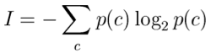
Entropy (Information Theory)
p(c1)

Slide 20
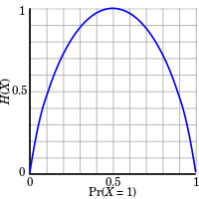
Tossing 1 Coin
=-p(head)log₂p(head)-p(tail)log₂p(tail)
If p(head)=p(tail)=0.5
=-2*0.5log₂0.5
=-2*0.5*(-1)=1 bit
p(c1)

Slide 21
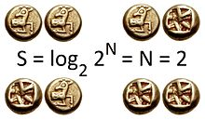
Entropy (Information Theory)
=-0.25log₂0.25 -0.25log₂0.25
-0.25log₂0.25 -0.25log₂0.25
=-4 * 1/4 * (-2)
= 2 bits
p(c1)

Slide 22
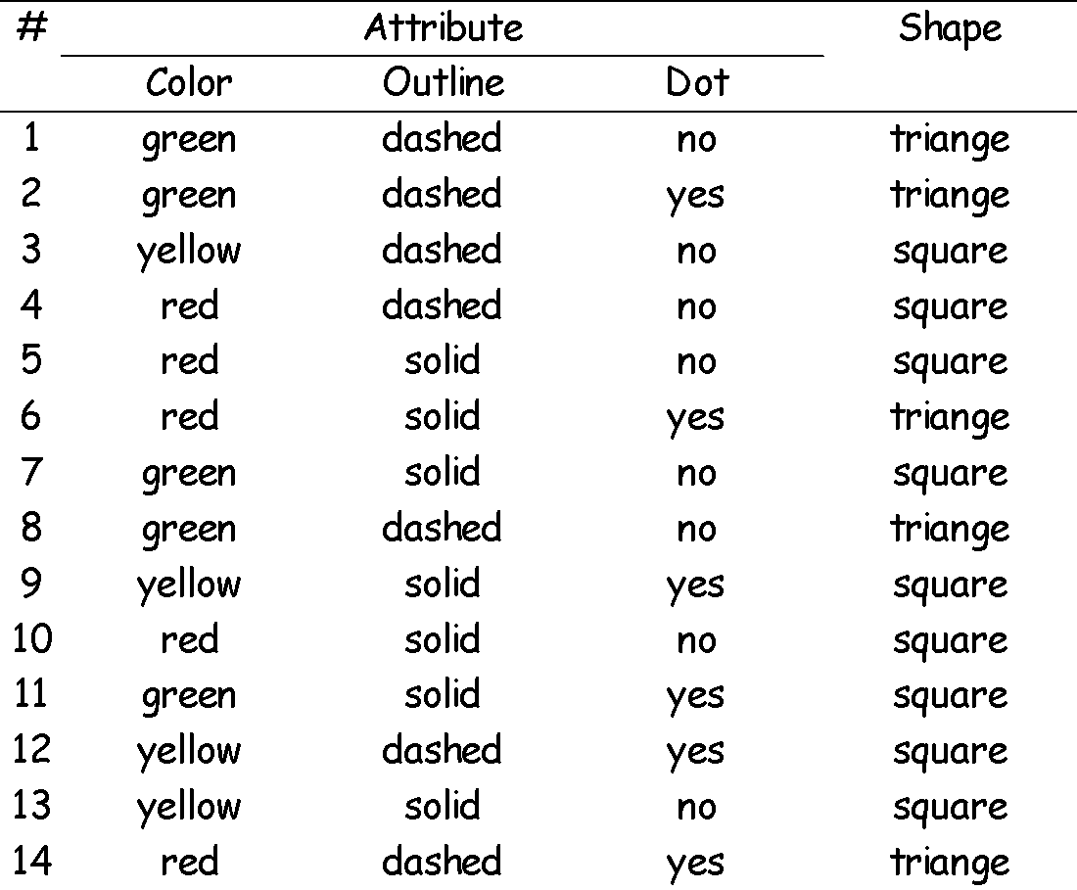
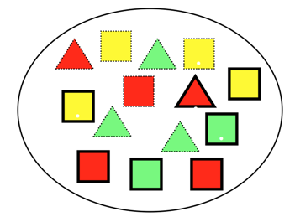
Shapes Classifier
Write a classifier to:
Given Color, Outline, Dot
Tell its shape

Slide 23
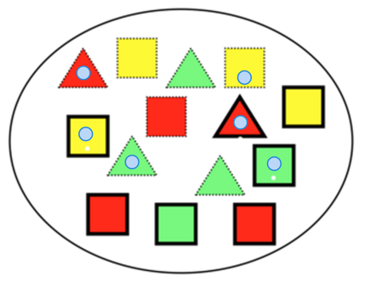
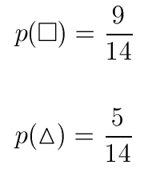
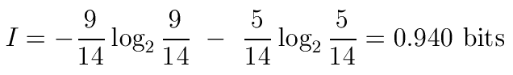
Entropy of the System
5 triangles
9 squares
class probabilities
entropy

Slide 24
Build the Decision Tree: How do I split the dataset?

Slide 25
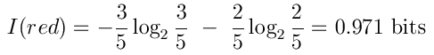
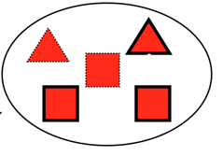
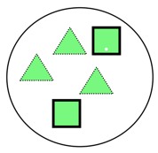
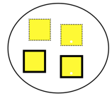
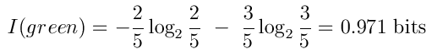
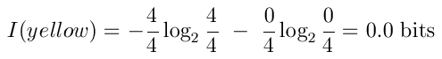
Split by Color
red
Color?
green
yellow

Slide 26
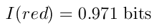
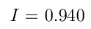
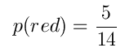
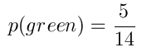
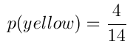
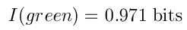
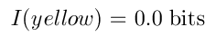
Split by Color
red
Color?
green
yellow

Slide 27
Split by Color
red
Color?
green
yellow

Slide 28
Choosing the Right Split
Attributes
Gain(Color) = 0.246
Gain(Outline) = 0.151
Gain(Dot) = 0.048
Heuristics: attribute with the highest gain is chosen
This heuristics is local (local minimization of impurity)

Slide 29
red
green
yellow
Gain(Outline) = 0.971 – 0 = 0.971 bits
Gain(Dot) = 0.971 – 0.951 = 0.020 bits

Slide 30
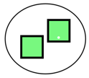
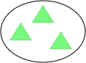
red
green
yellow

Slide 31
Gain(Outline) = 0.971 – 0.951 = 0.020 bits
Gain(Dot) = 0.971 – 0 = 0.971 bits
red
green
yellow

Slide 32


red
green
yellow

Slide 33
Decision Tree
Color
red
green
yellow
Dot
square
Outline
yes
no
dashed
solid
triangle
square
triangle
square

Slide 34
Regression ?
Same deal, but different "optimization function".
Can use standard deviation in place of "Entropy" or "Gini".
See here for a nice example using ID3 for regression. http://www.saedsayad.com/decision_tree_reg.htm

Slide 35
Break

Slide 36
Random Forest

Slide 37
Quiz

Slide 38
Quiz
Gradient Descent?
What's it for?
How it's done?

Slide 39
Ensemble Learning Methods
Combine Weaker Learners to make a Strong Learner:
Bagging (bootstrap aggregation)
Boosting
Bucket of Models
Stacking

Slide 40
Bucket of Models

Slide 41
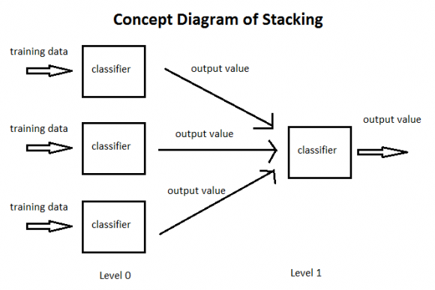
Stacking

Slide 42
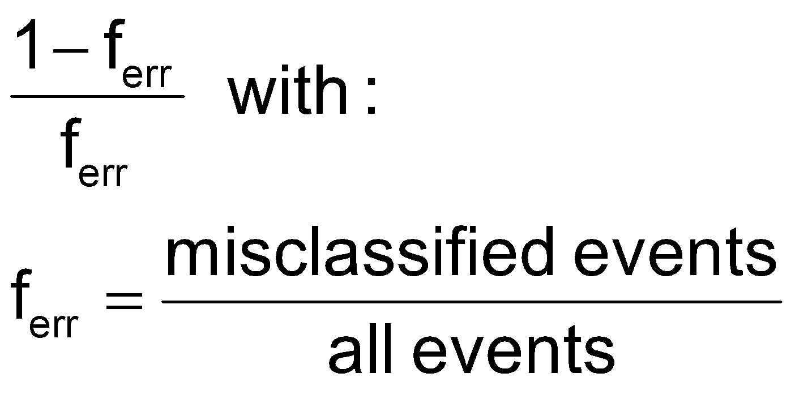
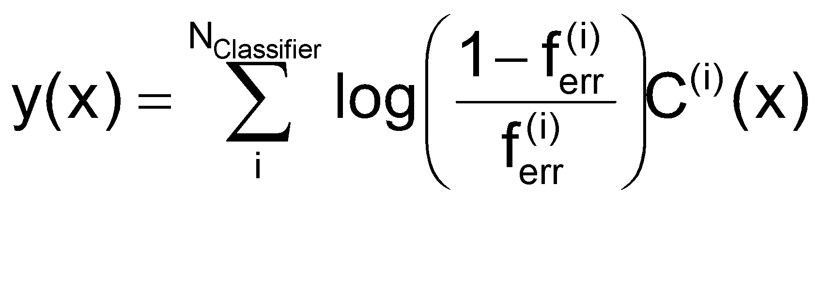
Boosting
Training Sample
classifier
C⁽⁰⁾(x)
AdaBoost re-weights events misclassified by previous classifier by:
re-weight
Weighted Sample
classifier
C⁽¹⁾(x)
re-weight
Weighted Sample
classifier
C⁽²⁾(x)
re-weight
classifier
C⁽³⁾(x)
AdaBoost weights the classifiers also using the error rate of the individual classifier according to:
Weighted Sample
re-weight
Weighted Sample
classifier
C^{(m)}(x)
Helge Voss
TMVA-Workshop, CERN, 21. January 2011 ― Decision Trees and Boosting

Slide 43
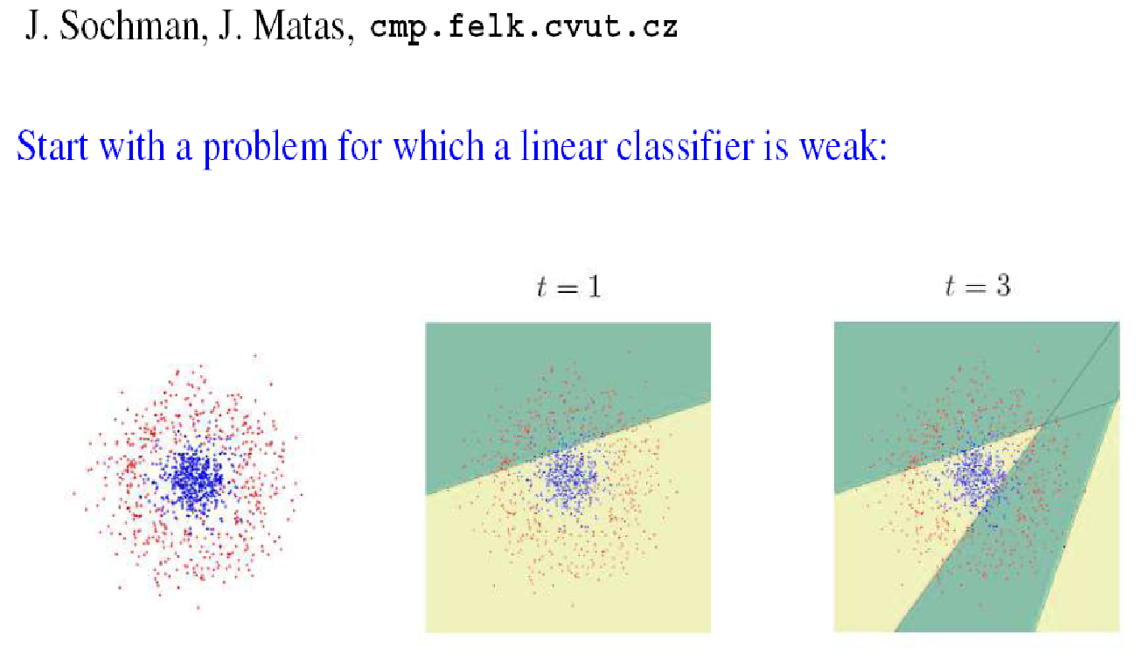
Boosting on a Linear Classifier
Helge Voss
TMVA-Workshop, CERN, 21. January 2011 ― Decision Trees and Boosting

Slide 44
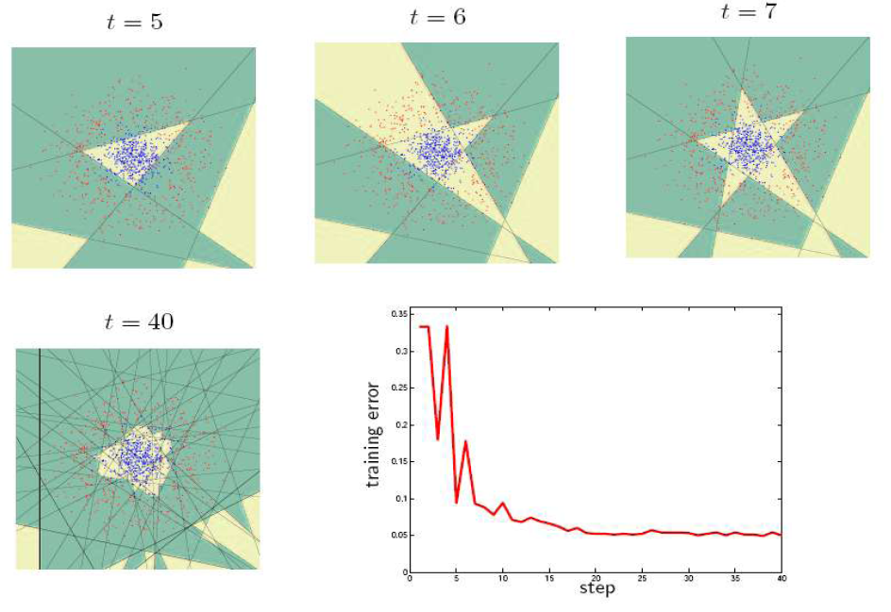
Boosting on a Linear Classifier
Helge Voss
TMVA-Workshop, CERN, 21. January 2011 ― Decision Trees and Boosting

Slide 45
Bagging (Bootstrap Aggregation)
Bagging or bootstrap aggregation a technique for reducing the variance of an estimated prediction function.
For classification, a committee of trees each
cast a vote for the predicted class.

Slide 46
.632 Bootstrapping
Sample with replacement
Return a sampled set with same number of elements as the previous one
Show demo!

Slide 47
Tree Bagging
Create bootstrap samples
from the training data
M features
N examples
....…

Slide 48
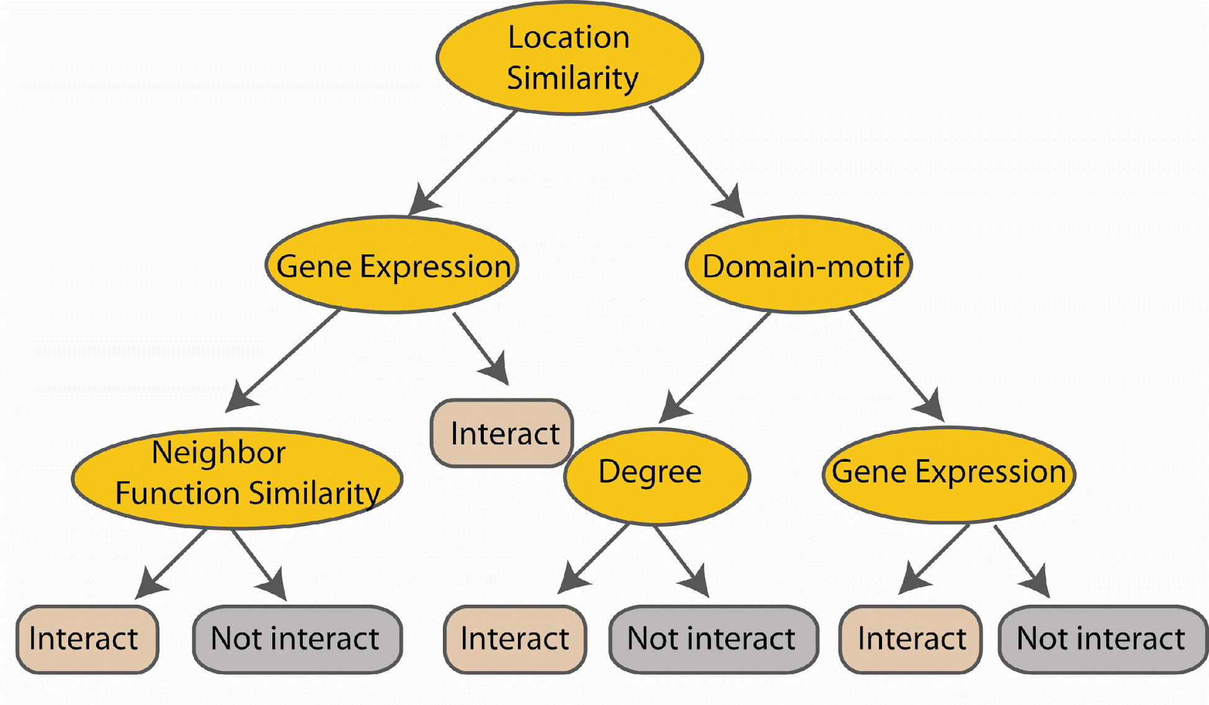
Tree Bagging
Construct a decision tree
M features
N examples
....…

Slide 49

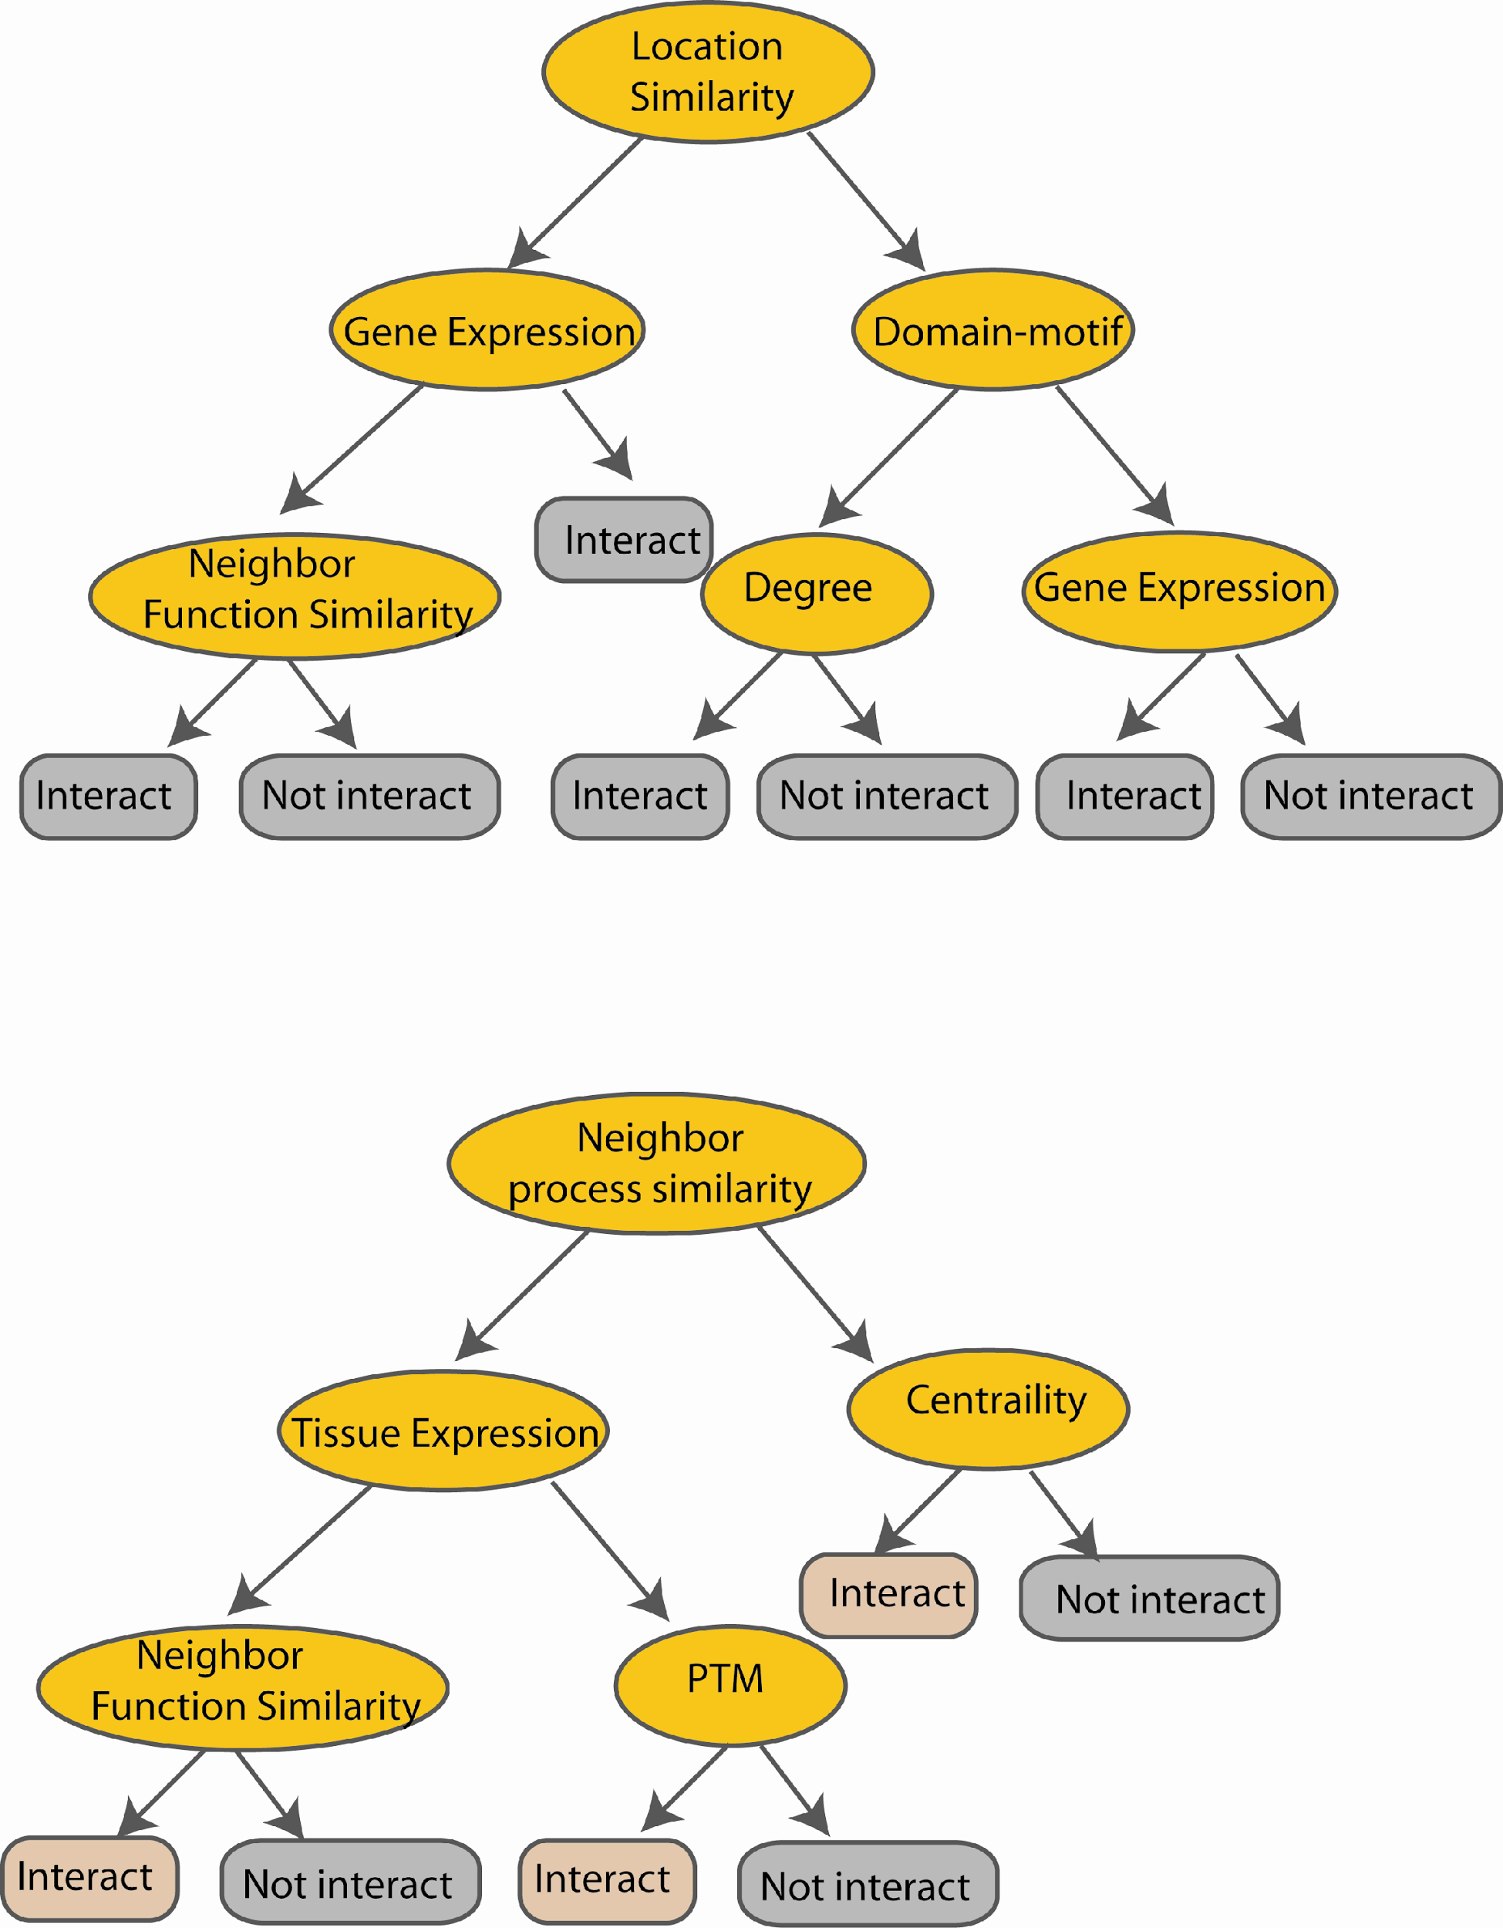
Tree Bagging
M features
N examples
Take the majority vote
....…
....…

Slide 50
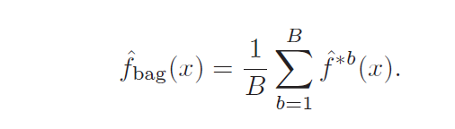
Tree Bagging
Z = {(x₁, y₁), (x₂, y₂), . . . , (x_{N}, y_{N})}
Z^{*b} where b = 1,.., B..
The prediction at input x
when bootstrap sample
b is used for training
http://www-stat.stanford.edu/~hastie/Papers/ESLII.pdf (Chapter 8.7)

Slide 51
Random Forest
- Extension to Tree Bagging
Random forest classifier, an extension to
bagging which uses de-correlated trees.
Why?

Slide 52
Start from Full Data Set
Training Data
M features
N examples

Slide 53
Bootstrap
Create bootstrap samples
from the training data
M features
N examples
....…

Slide 54
Construct Trees
Use random subset of features
At each node in choosing the split feature
choose only among m<M features
M features
N examples
....…

Slide 55
Random Forest
Create decision tree
from each bootstrap sample
M features
N examples
....…
....…

Slide 56
Random Forest
Create decision tree
from each bootstrap sample
M features
N examples
Take majority vote
....…
....…

Slide 57
Spark ML

Slide 58
Spark ML Components
Transformers & Estimators
Fit (i.e. train)
Model
DataFrame
Transform
DataFrame
Model
DataFrame

Slide 59
Spark ML Pipeline Components
Transformers & Estimators
pipeline.fit(dataframe) -> model
model.transform(dataframe) -> dataframe

Slide 60
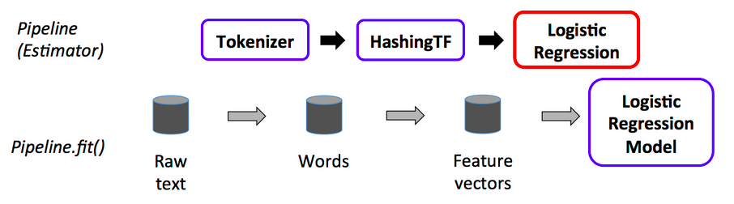
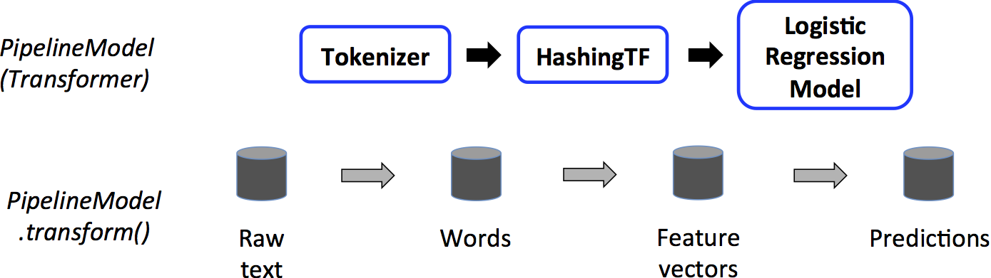
Spark ML

Slide 61
Demo

Slide 62
Assignment

Slide 63
Hands-on

